Slide 1

Employee Turnover Prediction Model
Benjy Manning, Cecilia Zhang, Sahar Jamal

Slide 2
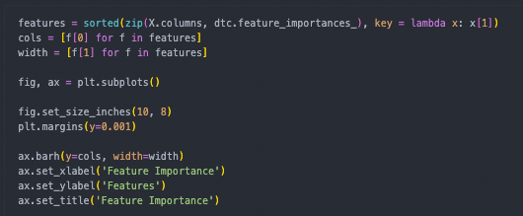
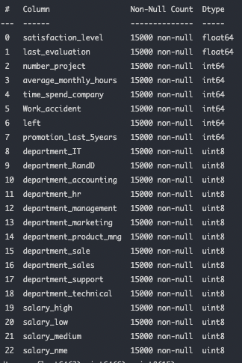
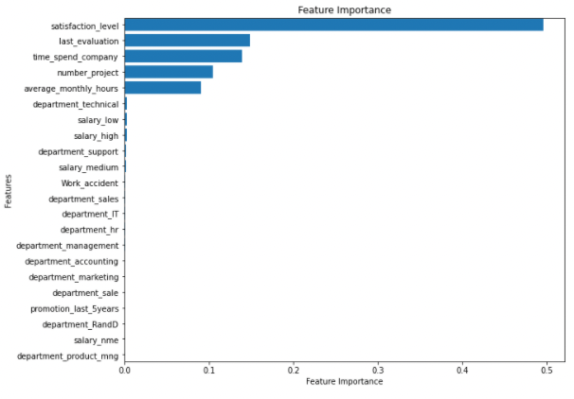
Selecting Data Features
Notes:
The initial data set had 22 columns of data and 15000 records. This data set was found on kaggle. We used some code to determine what features were most important to include in our model. Majority of these columns were not logical to collect this data. They were not broad enough to apply to everyone who might want to utilize or visit this app. This then left us with 5 important features we would collect about the subject in order to predict their outcome. These data points are satisfaction level, last evaluation, time spent with company, number of projects, and average monthly hours.

Slide 3



Programming Tools and Components

Slide 4
Model Training & Testing
^{Linear & Logistic Regression}
on a Non-scaled Data vs on Scaled Data
KNN on Non-scaled and Scaled Data
Notes:
A large company survery 15000 employees and kept record. This data set was initially intended for HR analytics so we thought what better than to make it an fully functioning app

Slide 5

HTML & Flask

Slide 6
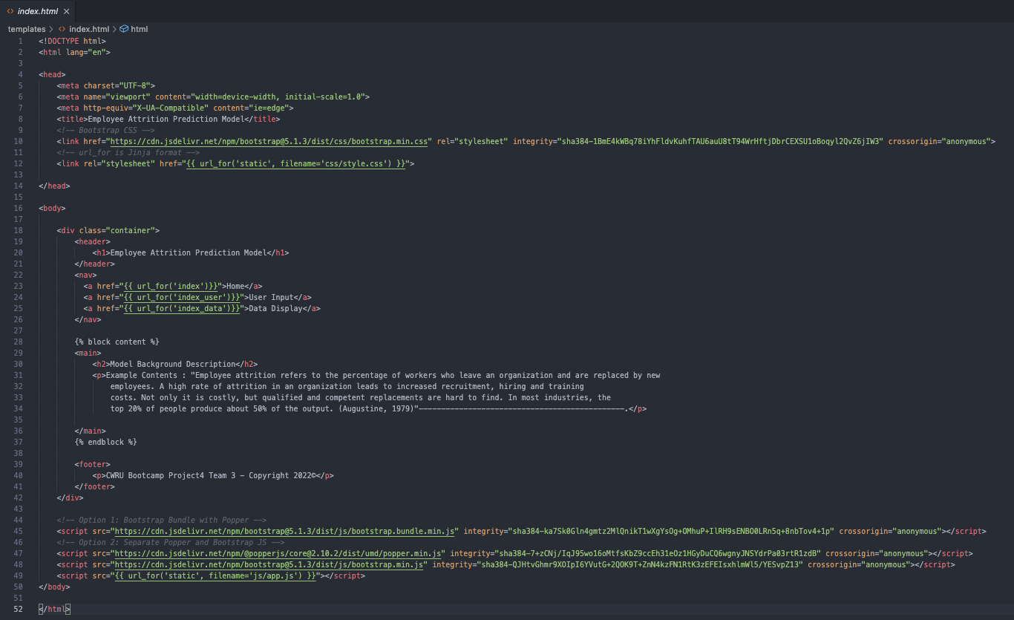
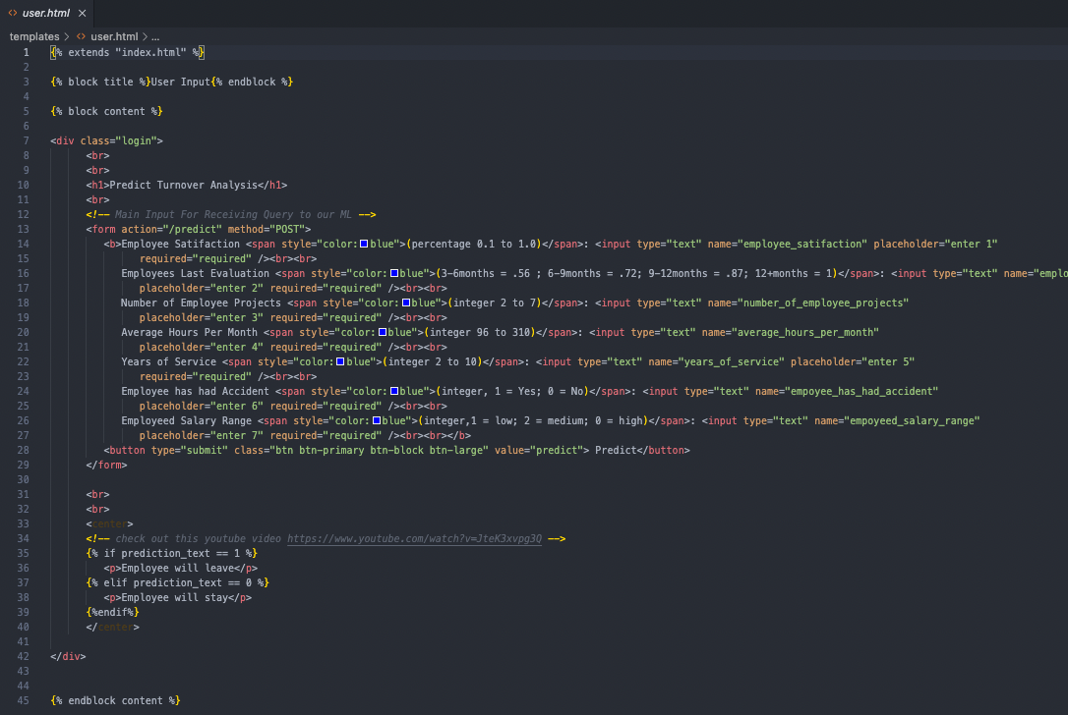

Slide 7


Hosting and Database Architecture

Slide 8
Building the Database & Storing the Data

Slide 9
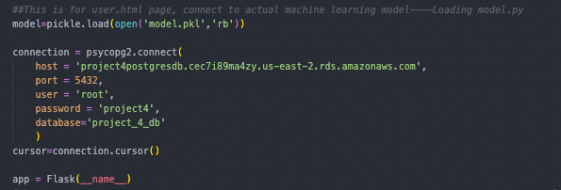
Hosting the Database & connecting via HTML

Slide 10
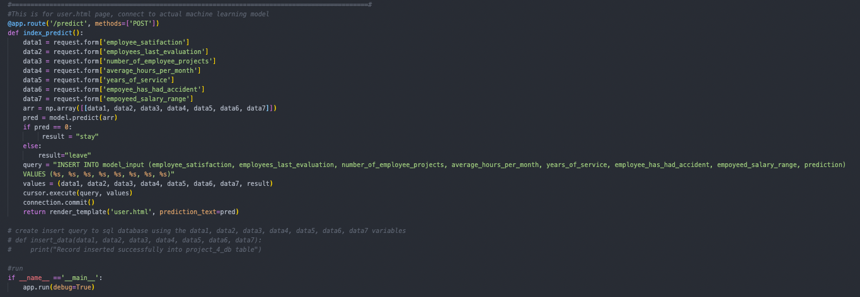
Connecting Modeled Data to Flask

Slide 11

https://flaskproject5.herokuapp.com/data

